Slide 1
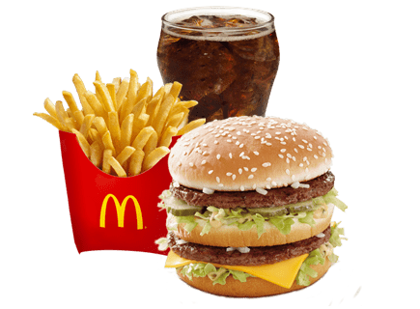
McDonald's Menu Nutritional Analysis presentation
This Photo by Unknown Author is licensed under CC BY-NC

Slide 2
Index
2
Nutrition Description Of Menu Items
Tools And Technologies
Challenges Faced during Analysis

Slide 3
Nutrition Description Of McDonalds's menu items
3
McDonald's is one of the world's largest and most recognizable fast-food chains, known for its burgers, fries, and signature items like the Big Mac
The McDonald's nutritional Description provides detailed information about the nutritional content of various menu items.
This includes the name of each item, its serving size, and nutritional details such as calories, fat, carbohydrates, protein, and more. For example, for each item like a burger or fries, you can see how many calories it has, how much fat it contains, and other key nutritional fact.
Most of the menu items have protein content within the range of 0-20 grams, Carbohydrates within the range of 30-70 grams, Most of the menu items have a total fat content within the range of 0-20 grams. sugar level within Range of (0-8) and have calories within the range of 185 t0 285. Ensuring that products meet food regulatory standards.
Nutritional data enables customers to customize their orders based on dietary preferences and needs. Providing detailed nutritional information can educate customers about the health benefits of products, leading to better customer engagement and loyalty Nutritional description helps in developing new products that specific dietary needs and preferences, such as low-calorie, low-sugar, or high-protein items. Providing clear and detailed nutritional information can enhance Business growth also. Overall, the Nutritional description of menu items is a valuable tool for anyone interested in the nutrition of McDonald's food.

Slide 4
Challenges Faced during Analysis
Data Quality and Consistency
Inconsistencies and Missing Values: Nutritional datasets can often have missing or inconsistent values. Handling these missing values and ensuring data consistency across all items is a major challenge.
Data Cleaning: This involves detecting and correcting (or removing) inaccurate records from the dataset . It can be time-consuming and requires careful attention.
Removing Outlier:
The major Challenge I Faced While Analyzing Dataset is to remove Outlier . Dataset has many dimension which are essential for analysis and has many outlier which will weight the analysis. Some variable such as Calories, fat, protein.
Outliers can significantly affect the results of statistical analyses and visualizations, sometimes skewing them. Deciding whether to remove an outlier should consider its impact on the analysis.
Removing outliers might lead to a loss of valuable information. Some outliers might be valid data points that provide important insights into extreme dietary patterns or specific menu items.

Slide 5
Tools & Technology
The tools and technology used for analyzing the McDonald's nutritional dataset.
I used Python for analyzing this data and Various Python libraries.
Jupyter Notebook:
Purpose: Interactive computing environment. Jupyter Notebook is an open-source web application that allows you to create and share documents containing live code, equations, visualizations, and narrative text.
1)Pandas :
Purpose: Data manipulation and analysis.
2) Matplotlib:
Purpose: Data visualization.
3)Seaborn:
Purpose: Interactive computing environment.
4)NumPy:
Purpose: Numerical computing and statistics.

